Slide 1

Consumer Insights Ad_Hoc Analysis

Slide 2
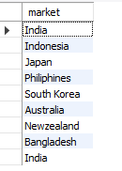
Q1: Provide the list of markets in which customer "Atliq Exclusive" operates its business in the APAC region
SELECT market FROM dim_customer WHERE customer = "Atliq Exclusive" AND region = "APAC";

Slide 3

Q2: What is the percentage of unique product increase in 2021 vs. 2020? The final output contains these fields,
unique_products_2020
unique_products_2021
percentage_chg
WITH UniqueProductCounts AS (
SELECT
fiscal_year,
COUNT(DISTINCT product_code) AS unique_product_count
FROM
fact_sales_monthly
WHERE
fiscal_year IN (2020, 2021)
GROUP BY
fiscal_year
)
SELECT
COALESCE((SELECT unique_product_count FROM UniqueProductCounts WHERE fiscal_year = 2020), 0) AS unique_products_2020,
COALESCE((SELECT unique_product_count FROM UniqueProductCounts WHERE fiscal_year = 2021), 0) AS unique_products_2021,
CASE
WHEN COALESCE((SELECT unique_product_count FROM UniqueProductCounts WHERE fiscal_year = 2020), 0) = 0 THEN NULL
ELSE ((COALESCE((SELECT unique_product_count FROM UniqueProductCounts WHERE fiscal_year = 2021), 0) -
COALESCE((SELECT unique_product_count FROM UniqueProductCounts WHERE fiscal_year = 2020), 0)) * 100.0 /
COALESCE((SELECT unique_product_count FROM UniqueProductCounts WHERE fiscal_year = 2020), 0))
END AS percentage_chg
FROM
UniqueProductCounts
LIMIT 1;

Slide 4
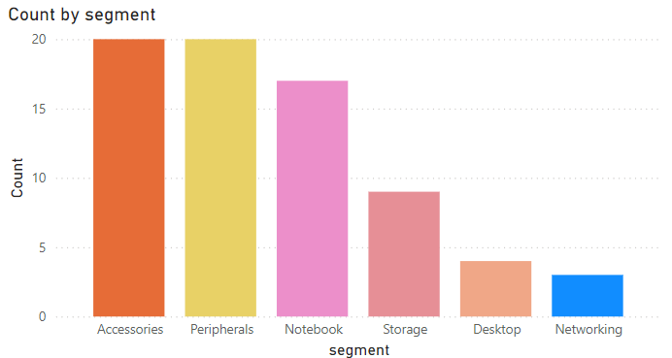
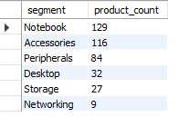
Q3. Provide a report with all the unique product counts for each segment and sort them in descending order of product counts.
The final output contains 2 fields,
segment
product_count
SELECT
segment,
COUNT(DISTINCT product_code) AS product_count
FROM
dim_product
GROUP BY
segment
ORDER BY
product_count DESC;

Slide 5
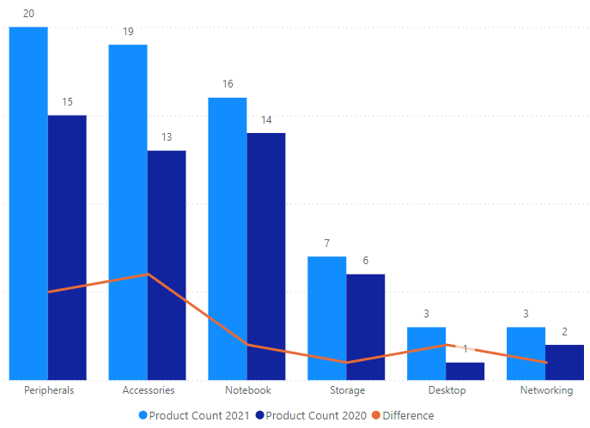
Q4 : Follow-up: Which segment had the most increase in unique products in 2021 vs 2020? The final output contains these fields,
segment
product_count_2020
product_count_2021
difference
WITH ProductCounts AS (
SELECT
b.segment,
a.fiscal_year,
COUNT(DISTINCT b.product_code) AS product_count
FROM
fact_sales_monthly a
JOIN
dim_product b ON a.product_code = b.product_code
WHERE
a.fiscal_year IN (2020, 2021)
GROUP BY
b.segment, a.fiscal_year
)
SELECT
a.segment,
COALESCE(b.product_count, 0) AS product_count_2020,
COALESCE(a.product_count, 0) AS product_count_2021,
COALESCE(a.product_count, 0) - COALESCE(b.product_count, 0) AS difference
FROM
ProductCounts a
LEFT JOIN
ProductCounts b ON a.segment = b.segment AND b.fiscal_year = 2020
WHERE
a.fiscal_year = 2021
ORDER BY
difference DESC
LIMIT 1;

Slide 6

Q5 : Get the products that have the highest and lowest manufacturing costs. The final output should contain these fields,
product_code
product
manufacturing_cost
WITH CostExtremes AS (
SELECT
MAX(manufacturing_cost) AS max_cost,
MIN(manufacturing_cost) AS min_cost
FROM
fact_manufacturing_cost
)
SELECT
b.product_code,
b.product,
a.manufacturing_cost
FROM
fact_manufacturing_cost a
JOIN
dim_product b ON a.product_code = b.product_code
WHERE
a.manufacturing_cost = (SELECT max_cost FROM CostExtremes)
OR
a.manufacturing_cost = (SELECT min_cost FROM CostExtremes);

Slide 7
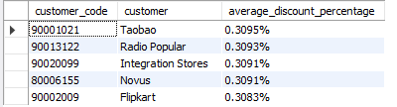
Q6 : Generate a report which contains the top 5 customers who received an average high pre_invoice_discount_pct for the fiscal year 2021 and in the Indian market. The final output contains these fields,
customer_code
customer
average_discount_percentage
WITH high_average_discount_pct AS (
SELECT
customer_code,
CONCAT(ROUND(AVG(pre_invoice_discount_pct), 4), "%") AS average_discount_percentage
FROM
fact_pre_invoice_deductions
WHERE
fiscal_year = 2021
GROUP BY
customer_code
)
SELECT
a.customer_code,
b.customer,
a.average_discount_percentage
FROM
high_average_discount_pct a
JOIN
dim_customer b
ON a.customer_code = b.customer_code
ORDER BY
a.average_discount_percentage DESC
LIMIT 5;

Slide 8
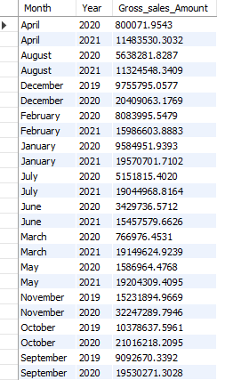
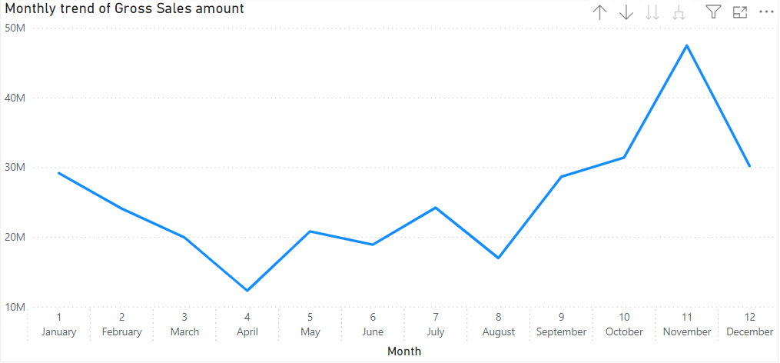
Q.7 Get the complete report of the Gross sales amount for the customer “Atliq Exclusive” for each month. This analysis helps to get an idea of low and high-performing months and take strategic decisions. The final report contains these columns:
Month
Year
Gross sales Amount
SELECT
MONTHNAME(a.date) AS month_name,
YEAR(a.date) AS year,
SUM(a.sold_quantity * b.gross_price) AS gross_sales_amount
FROM
fact_sales_monthly a
JOIN
fact_gross_price b
ON a.product_code = b.product_code
JOIN
dim_customer c
ON a.customer_code = c.customer_code
WHERE
c.customer LIKE "Atliq Exclusive"
GROUP BY
MONTHNAME(a.date),
YEAR(a.date)
ORDER BY
MONTHNAME(a.date) ASC;

Slide 9

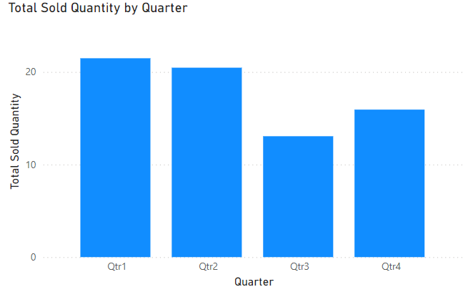
Q8: In which quarter of 2020, got the maximum total_sold_quantity? The final output contains these fields sorted by the total_sold_quantity,
Quarter
Total_sold_quantity
SELECT
CASE
WHEN MONTH(date) IN (9, 10, 11) THEN 'Qtr1'
WHEN MONTH(date) IN (12, 1, 2) THEN 'Qtr2'
WHEN MONTH(date) IN (3, 4, 5) THEN 'Qtr3'
WHEN MONTH(date) IN (6, 7, 8) THEN 'Qtr4'
END AS Quarter,
CONCAT(SUM(sold_quantity)/1000000,"M") AS total_sold
FROM fact_sales_monthly
GROUP BY Quarter;

Slide 10

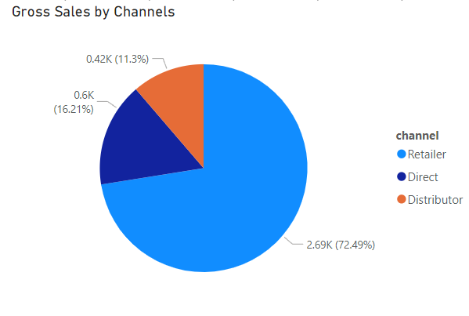
Q9 : Which channel helped to bring more gross sales in the fiscal year 2021 and the percentage of contribution? The final output contains these fields,
channel
gross_sales_mln
percentage
SELECT
c.channel,
CONCAT(
ROUND(SUM(a.sold_quantity * b.gross_price) / 1000000, 2),
"M"
) AS gross_sales_mln,
CONCAT(
ROUND(
SUM(a.sold_quantity * b.gross_price) / (
SELECT
SUM(a.sold_quantity * b.gross_price)
FROM
fact_sales_monthly a
JOIN
fact_gross_price b
ON a.product_code = b.product_code
) * 100,
2
),
"%"
) AS percentage
FROM
fact_sales_monthly a
JOIN
fact_gross_price b
ON a.product_code = b.product_code
JOIN
dim_customer c
ON a.customer_code = c.customer_code
GROUP BY
c.channel;

Slide 11
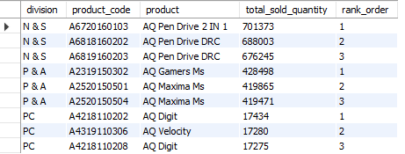
Q10 : Get the Top 3 products in each division that have a high total_sold_quantity in the fiscal_year 2021? The final output contains these fields,
division
Product_code
product
total_sold_quantity
Rank_order
WITH RankedProducts AS (
SELECT
b.division,
a.product_code,
b.product,
SUM(a.sold_quantity) AS total_sold_quantity,
RANK() OVER (PARTITION BY b.division ORDER BY SUM(a.sold_quantity) DESC) AS rank_order
FROM
fact_sales_monthly a
JOIN
dim_product b ON a.product_code = b.product_code
WHERE
a.fiscal_year = 2021
GROUP BY
b.division, a.product_code, b.product
)
SELECT
division,
product_code,
product,
total_sold_quantity,
rank_order
FROM
RankedProducts
WHERE
rank_order <= 3
ORDER BY
division, rank_order;

Slide 12
Thank You

